Slide 1
INFRALINK THEME: FRONTIER TECHNOLOGY in MSME

Slide 2

Problem description
A digital platform for interdepartmental cooperation in urban governance would streamline coordination between multiple agencies, reducing resource wastage and delays caused by miscommunication. The platform would facilitate:
1. Data and Resource Sharing: Departments can exchange data on ongoing/upcoming projects, technical expertise, and available resources.
2. Task Scheduling & Reporting: Creation, scheduling, and assignment of tasks for inter-departmental projects, ensuring no overlap or rework.
3. Unified Project Planning: Identification of projects sharing the same site, allowing for collaborative phasing and execution to reduce costs and delays.
4. Training & Capacity Building: Hosting workshops, seminars, and training to enhance collaboration skills.
5. Discussion Forums: Separate spaces for intra-departmental, inter-departmental, and public discussions to foster communication and resolve issues.
This platform ensures smooth execution of urban projects, promoting efficient use of resources and timely delivery through proactive collaboration.

Slide 3
IDEA / SOLUTION
Role-based login system with distinct functions:
Project Heads: Create and manage projects, identify departments and assign them.
Department Heads: View relevant projects, assign tasks, manage Supervisors, reports to Project Head.
Supervisors: View and distribute tasks to workers, reports to Department Head.
Task scheduling using PERT charts, reporting, work distribution, notifications.
Alert & response mechanism between different users.
Real time location access of all ongoing projects and resource pooling.
Chatbot to assist Project Heads in identifying potential departments involved by giving a request.
Discussion forum for project-related communication and collaboration between different users.
Organizing online meetings for interactions of different users.
Tracking of Supervisors task completion progress.

Slide 4

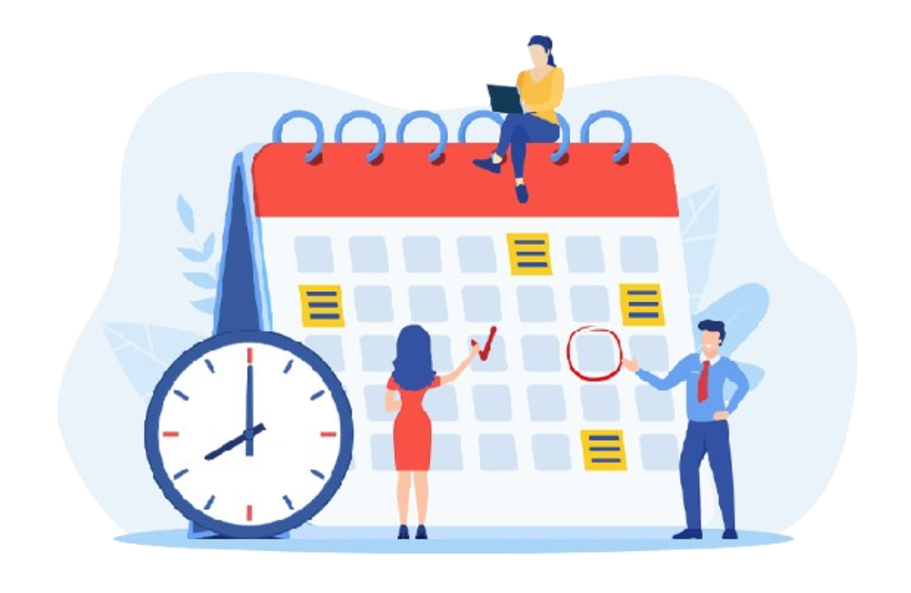
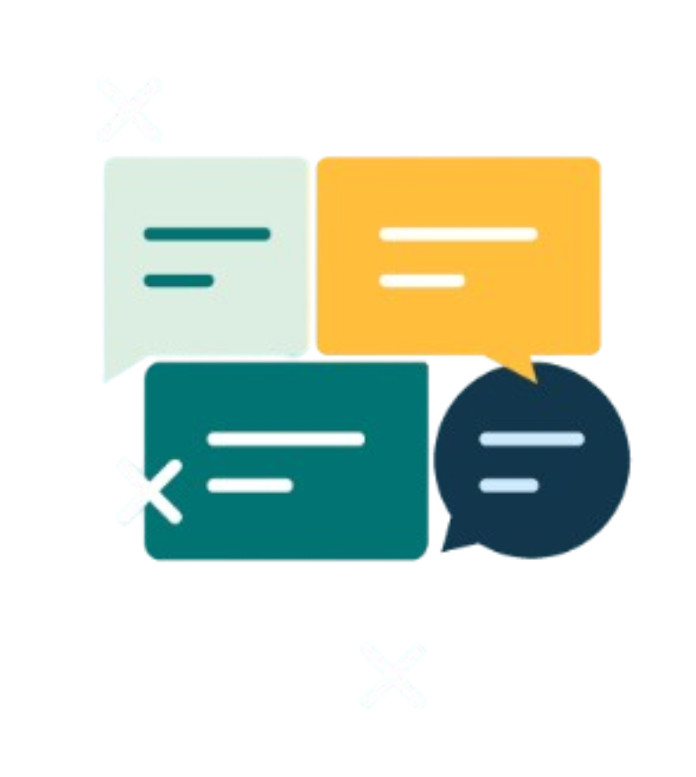
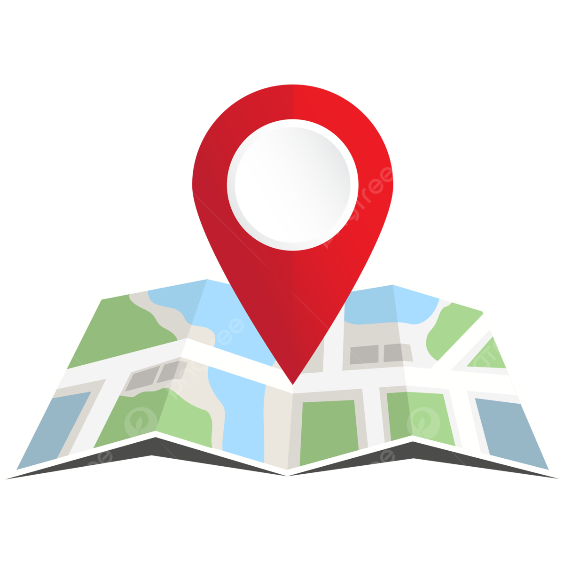


OBJECTIVES
Efficient resource management
Facilitate transparent discussions
Unified project phasing
Pre-emptive collaboration
Increase project efficiency
NOVELTY / UNIQUENESS
Task Scheduler using PERT chart
AI Integrated Chatbot
Dynamic Discussion Forum
Location based Collision Detection and Resource Pooling

Slide 5
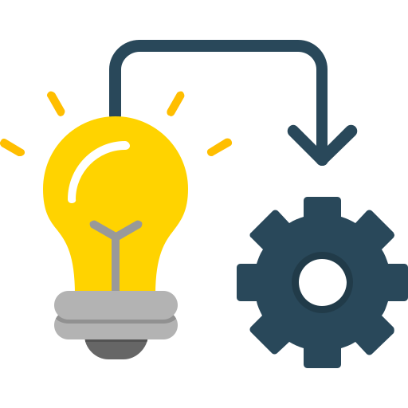
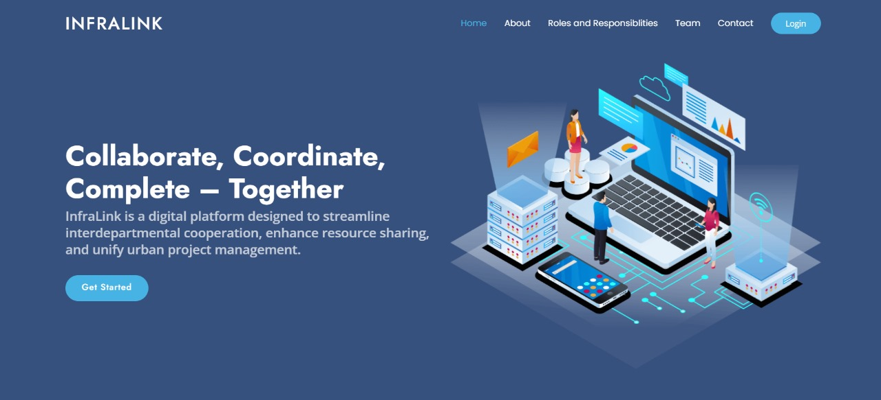
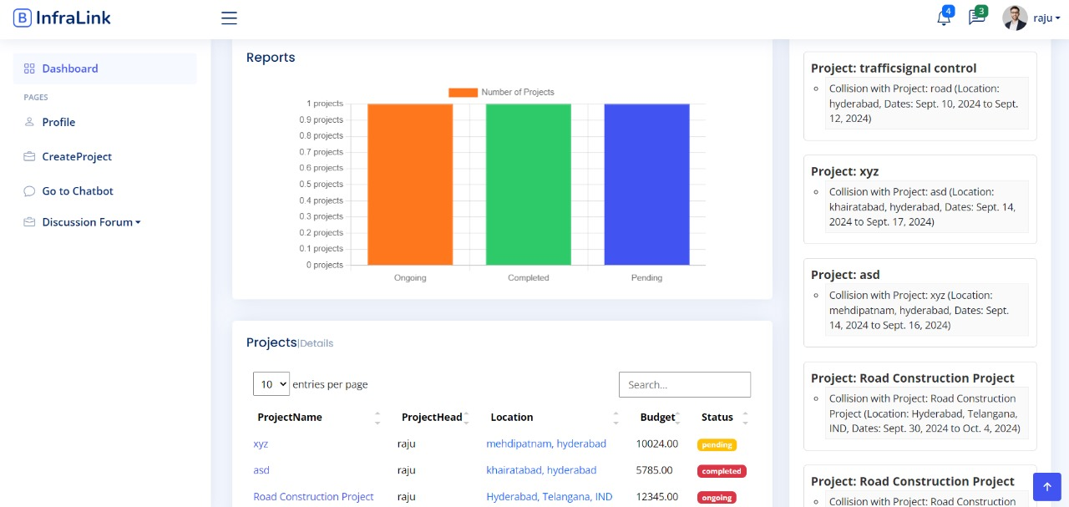
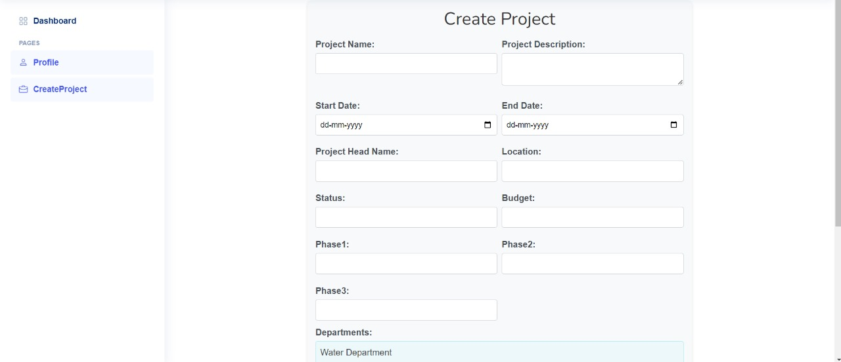
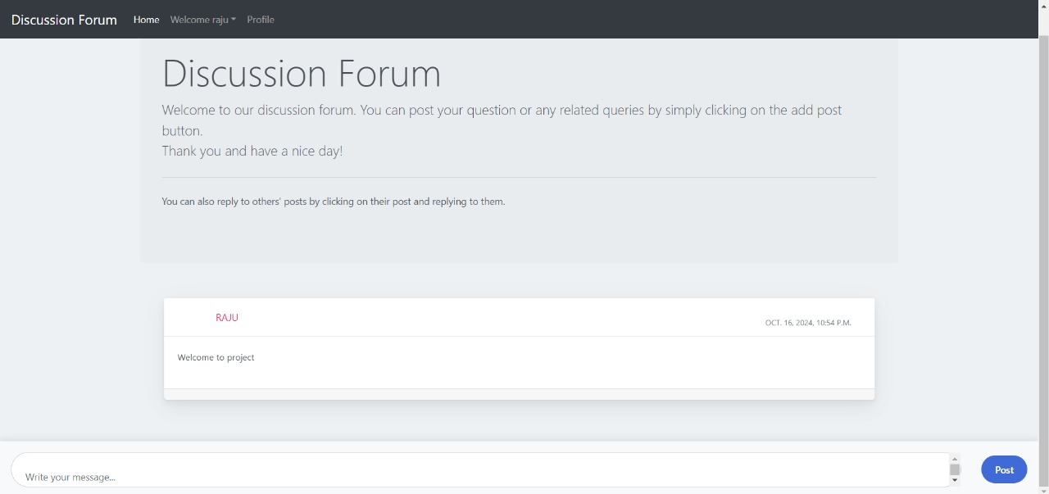
Design and implementation

Slide 6
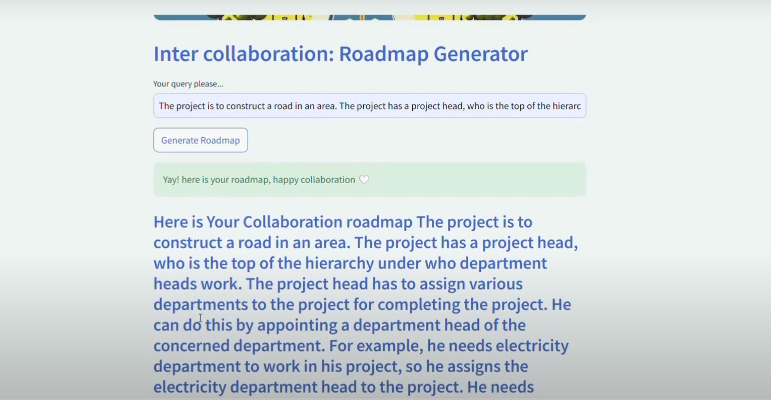
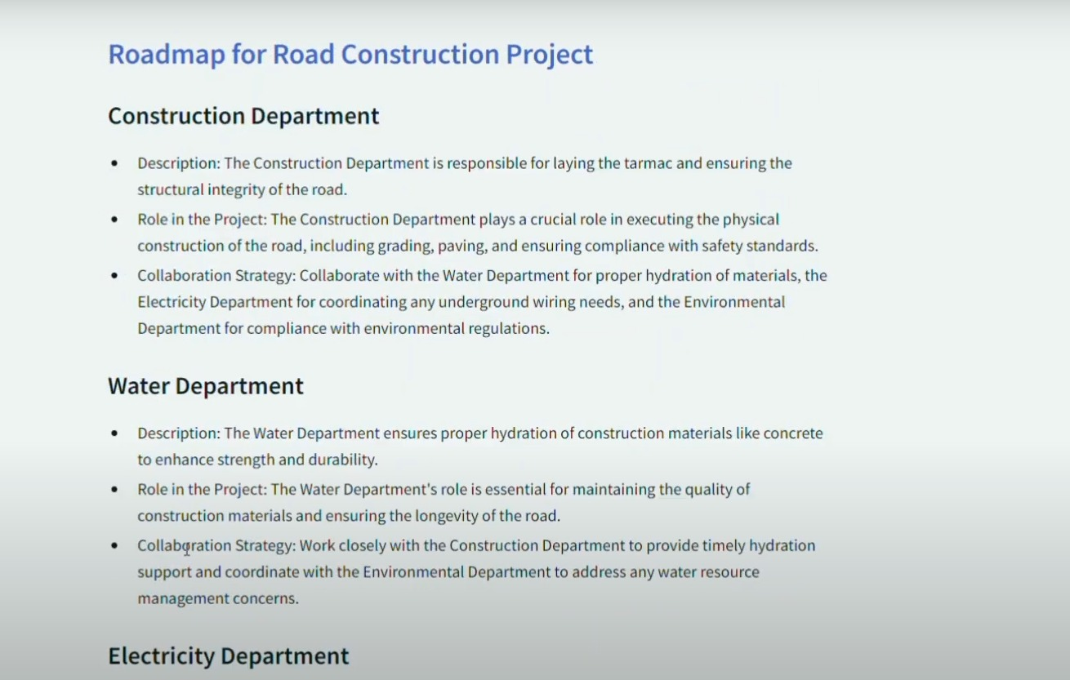
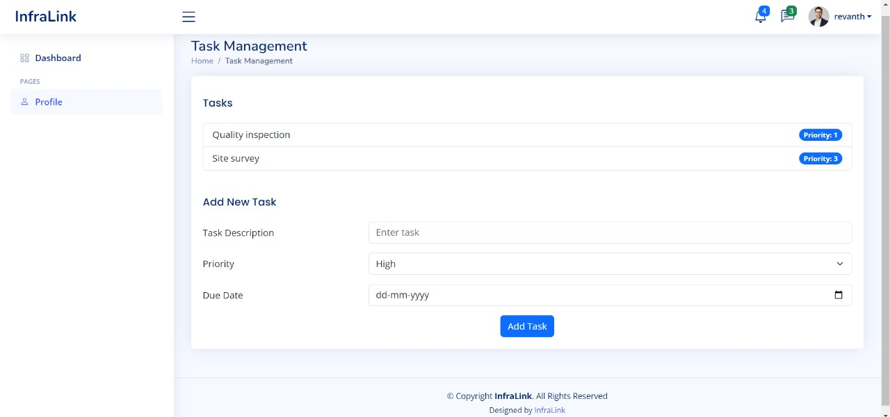
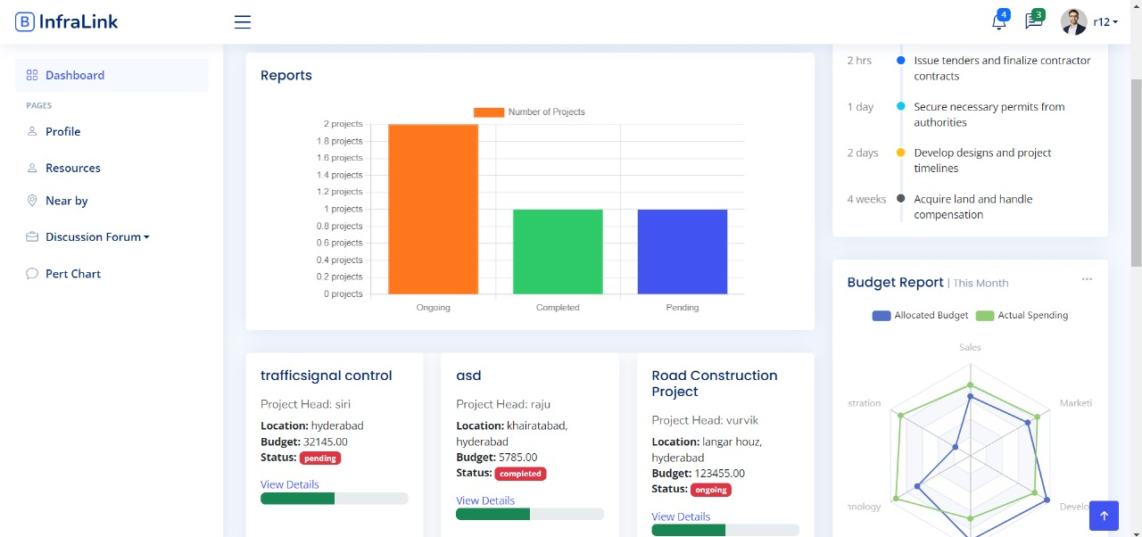
Design and implementation

Slide 7
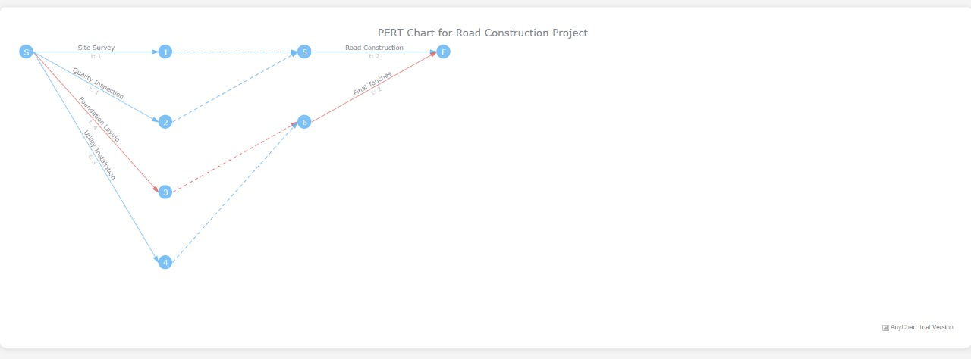
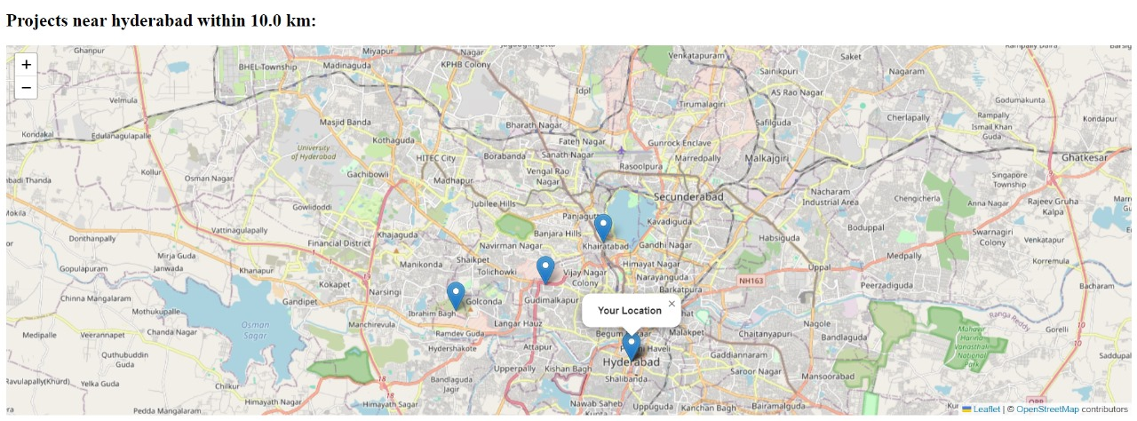
Design and implementation

Slide 8
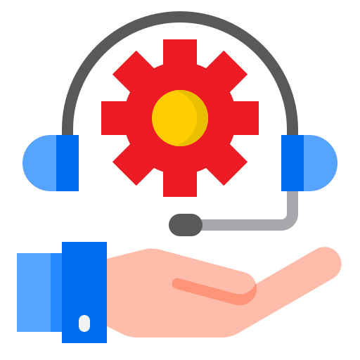
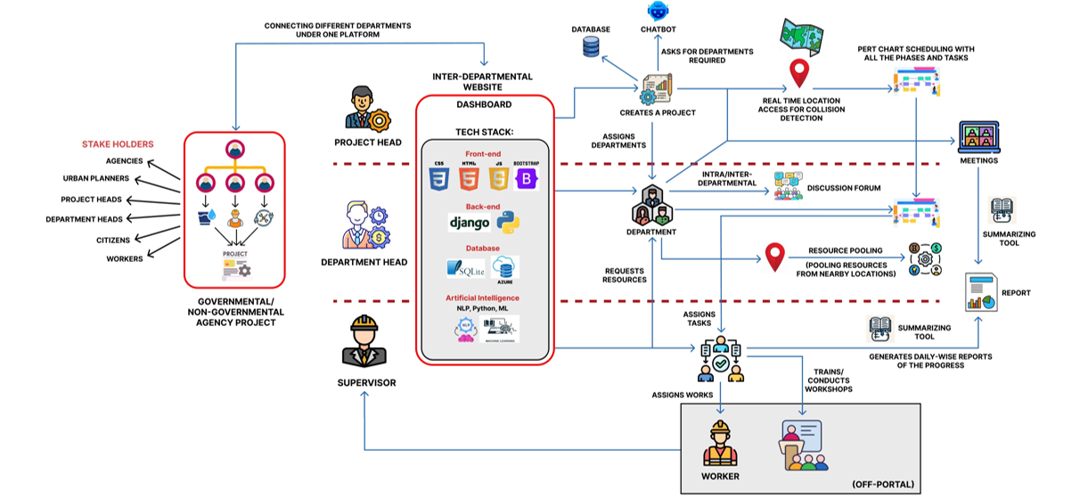
BLOCK DIAGRAM

Slide 9
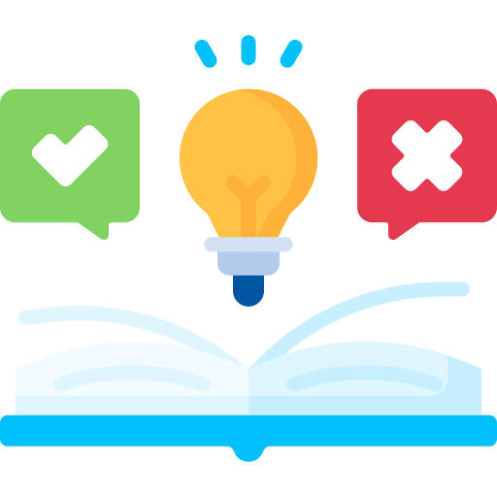
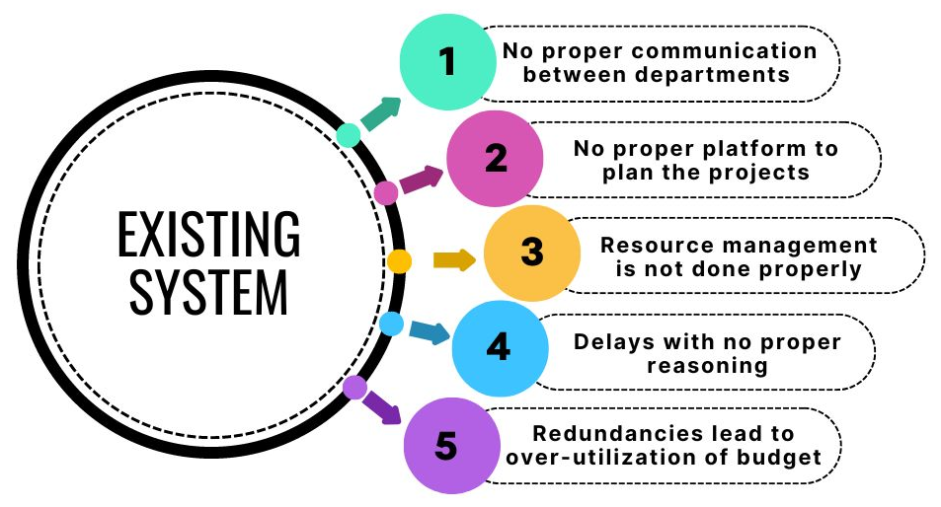

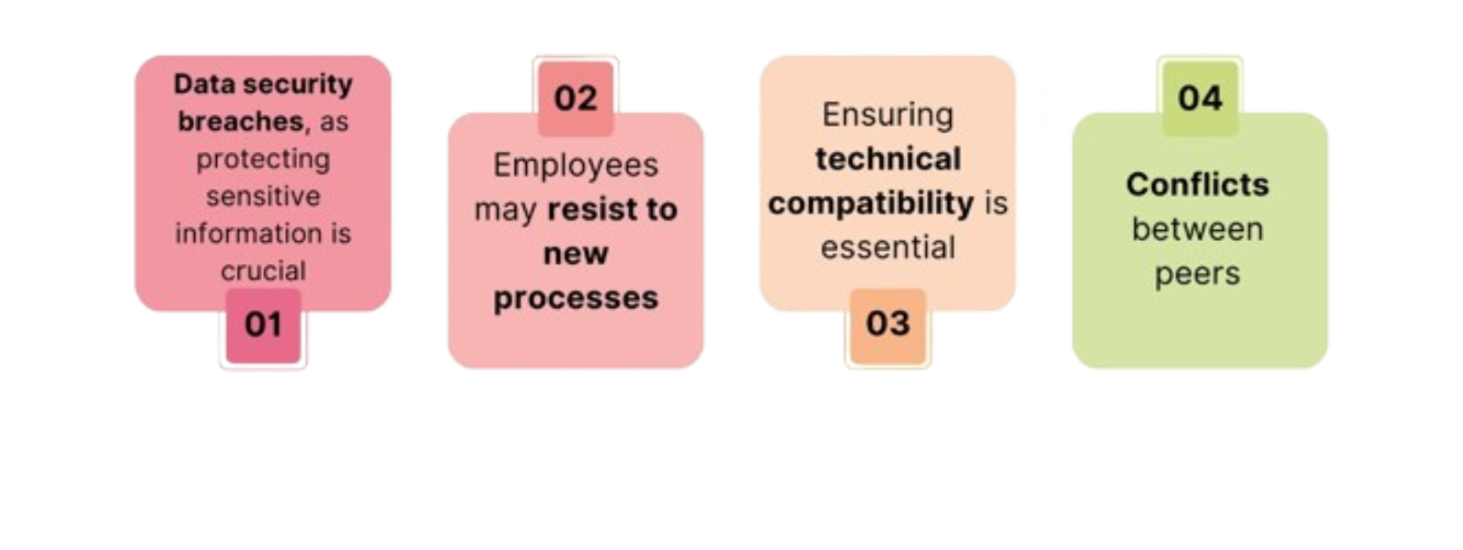

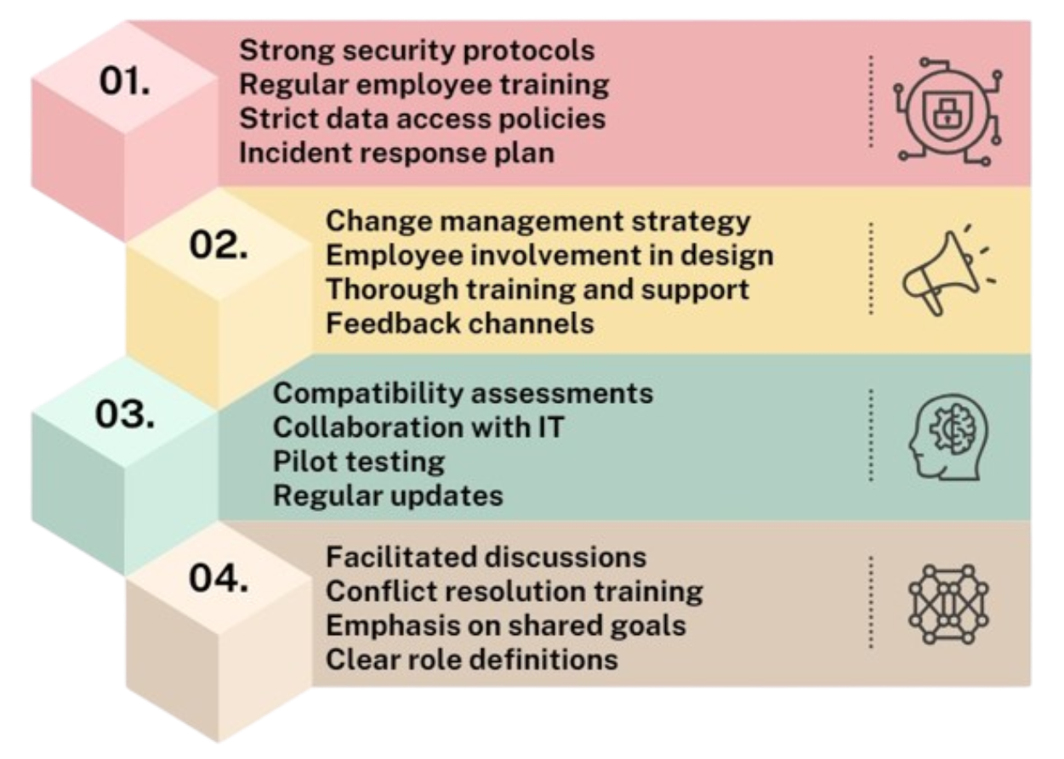
FEASIBILITY AND VIABILITY
Potential Risks in the System
Strategies to Overcome the Potential Risks
Uses a proven technology stack (Django, HTML, CSS, JavaScript, Python) for effective implementation, making the system scalable.
Efficient and streamlined systems that ensure an optimal market fit.
Addresses key issues like inter-departmental coordination and project collisions relevant to urban governance.
A straightforward and efficient system that replaces traditional methods, leading to cost savings.

Slide 10


SOCIAL / ENVIRONMENTAL IMPACT
Enhanced Collaboration: Strengthens inter-departmental communication, leading to better project results.
Empowerment of MSMEs: Boosts local businesses' capacity and creates job opportunities.
Improved Public Services: Facilitates timely infrastructure and service delivery to the community
Resource Optimization: Minimizes waste through efficient material usage.
Reduced Project Overlap: Decreases environmental harm from redundant construction activities.
Business scalability
• Urban Development: Improve teamwork in city planning and building projects.
• Government Agencies: Make project management easier across different departments.
• Construction Industry: Help contractors communicate and schedule better.
• Environmental Management: Support projects that focus on sustainability and saving resources.
• Public-Private Partnerships: Encourage cooperation between government and private companies.

Slide 11
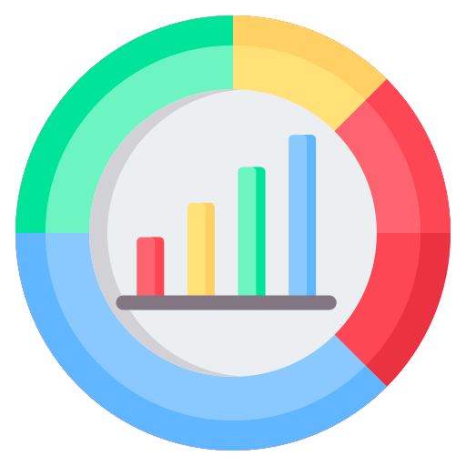

MARKET POTENTIAL OF IDEA
This innovation has significant market potential as it tackles issues in urban management and collaboration between departments. With more cities growing, there is an increasing need for digital tools that improve communication and resource sharing. Collaborating with government and private entities can further enhance its impact in urban development.
FINANCIAL PROJECTIONS
TRAVEL ALLOWANCE | INR 2,00,000
MENTOR | INR 3,00,000
TRAINING | INR 4,00,000
APIs | INR 1,50,000
DATABASE | INR 1,50,000
DEPLOYMENT | INR 1,50,000
MISCELLANEOUS | INR 1,50,000
GRAND TOTAL: INR 15,00,000

Slide 12
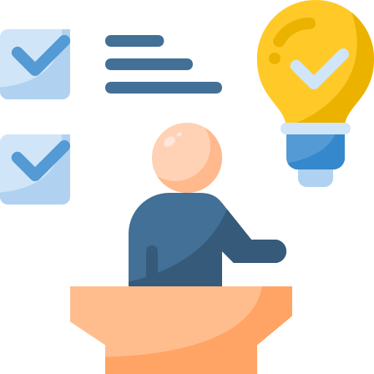

Conclusion
InfraLink is a role-based platform designed for interdepartmental coordination in urban projects. It improves resource utilization, reduces delays, and enhances communication through tools like chatbots, task scheduling, discussion forum, and video/audio summarization, fostering efficient project management and collaboration between multiple agencies for better urban governance and project execution.
References and research
Ministry of Housing and Urban Affairs
OpenCage API
National Smart Grid Mission
National Urban Policy Framework
Smart Cities Mission

Slide 13
Thank you

